Slide 1

CHINESE PHARMACEUTICALS LIMITED
Growth & Forecasting Plan - Sai Teja Pasula

Slide 2




ABOUT THE COMPANY
Chinese Pharmaceuticals (HK) Limited is a Hong Kong company supplying Chinese herbal medicine products.
Noto37 is its best-selling product, a Chinese herbal medicine used to control cholesterol and blood pressure levels.
BEST PRODUCT
Noto37
SALES CHANNEL
~ 1000 Retailers in Hong Kong & Macau
REVENUE PROPORTION
~ 80% during peak winter
TARGET SEGMENT
Cholesterol or Blood pressure patients

Slide 3

CURRENT PROBLEMS
COMPTETITIVE MARKET
INVENTORY MANAGEMENT
Chinese Pharma has a sizable market share of 40% in their target segment (cholesterol & blood pressure patients), but this segment has become highly competitive and is attracting new entrants.
Inventory has been managed based on the available leased warehouse space rather than any systematic analysis
Fluctuating demand and stock levels

Slide 4
$ 329,740,000
MARKET POTENTIAL
Prescription value of Herbal Medicines in Hong Kong market for the year 2012*
* Source : https://www1.hkexnews.hk/listedco/listconews/sehk/2015/0708/a5492/epura-20150622-13.pdf

Slide 5
SWOT ANALYSIS
THREATS
STRENGTHS
Traditional chinese medicines
Purapharm’s variety of herbal products
Retailers might prefer other brands in their prominent shelfs due to stock out
Long term effects of decreasing the testing times
Established raw material supplier
Quality product with raw material testing and proven history of curing ability
Well established roots in local market
Own Research & Development office through government
40% market share in the segment
T
S
OPPORTUNITIES
WEAKNESSES
Effective lead time forecasts at different touch points in the chain
Lease bigger warehouses / Own them
Online portal for orders to drug stores
Revenue sharing agreements with retailers
Customer profiling through data from retailers and design Targeted campaigns
Customer preferences/reviews about product through Surveys
O
W
Low cash flow
Limited storage space
Not a direct-to-consumer sales model
Larger lead times at manufactourer
Not well-planned promotions

Slide 6




RECOMMENDATIONS
CUSTOMERS
RETAILERS
Segmentation on Demographics (Age, Region)
Customer preferences about product through Surveys
Design Targeted Marketing Camapigns to acquire customers
Cluster the retail stores into High - Low - Medium value ones
Analyze factors like repeating customers / location / product visibility in shelfs / pricing in all retail clusters
Revenue sharing agreements with monthly targets
Influencer Billboards with targeted marketing messages
SUPPLY CHAIN
COMPETITORS
Cost benefit analysis for owning warehouses
Route optimisation post raw material testing
Accurate lead time forecasts at different touch points in the supply chain considering extrenal variables like marketing spends, holidays, drought conditions in China
Analyze the points of parity and points of differentiation of our products and competitors as well
Implement effective pricing strategies to match the competitor

Slide 7
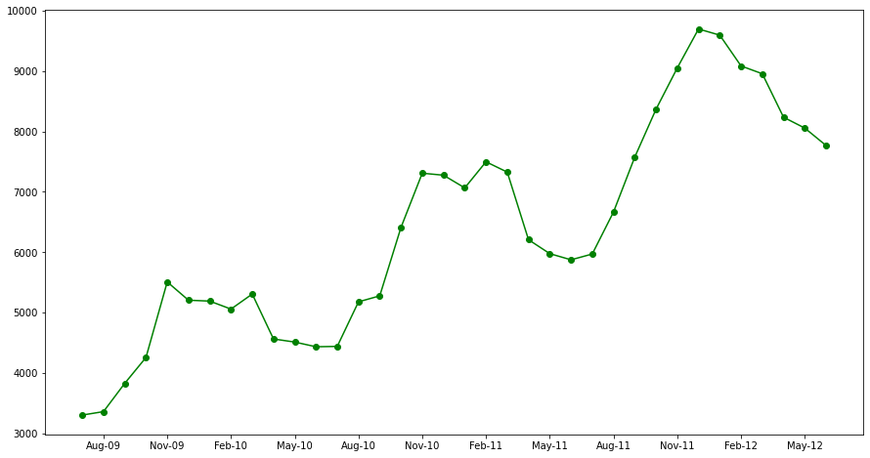
DEMAND FORECASTING
Provided with monthly sales data from July 2009 – June 2012 (36 months)
Monthly Sales of Chinese Pharmaceuticals
Sales
Train : July 2009 to March 2012
Holdout

Slide 8
DEMAND FORECASTING
Comparing the Root Mean Squared Error (RMSE) & Weighted Absolute Percentage Error (WAPE) of the training and the holdout datasets to avoid over fitting
SIMPLE EXPONENTIAL SMOOTHING
MODEL PERFORMANCE METRICS
α = 0.4
α = 0.2
ALPHA = 0.4 | DATA | RMSE | WAPE
 | TRAIN | 876 | 11.24%
 | HOLDOUT | 1029 | 12.60%
9030
8478
FORECASTS
ALPHA = 0.2 | DATA | RMSE | WAPE
 | TRAIN | 1164 | 15.22%
 | HOLDOUT | 498 | 5.72%
ACTUAL VALUES
8235
8055
7767

Slide 9
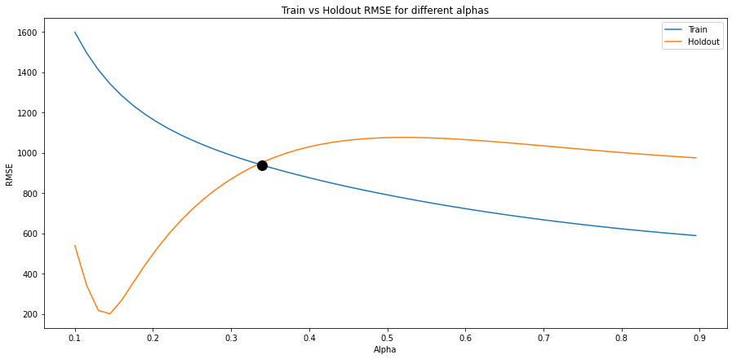
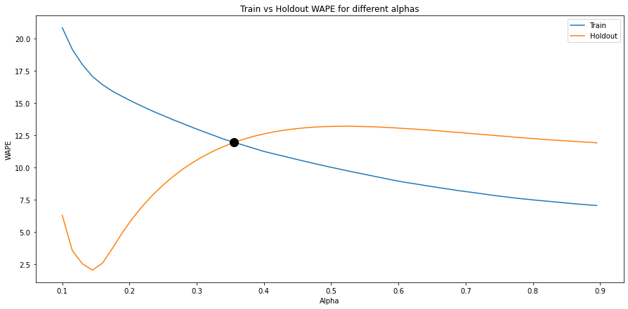
DEMAND FORECASTING
The value of the smoothing parameter has been varied from 0.1 to 0.9
The best smoothing parameter is 0.34 when RMSE is the metric and 0.355 when WAPE is the metric
Train vs Holdout RMSE for different alphas
Train vs Holdout WAPE for different alphas

Slide 10
DEMAND FORECASTING
Accounted for Trend & seasonality using Holt Winters exponential smoothing and SARIMA models
The best model is Holt Winters Exponential smoothing when the Train & Holdout’s RMSE, WAPE are compared
BEST SMOOTHING
HOLT WINTERS
sARIMA
MODEL PERFORMANCE METRICS
ALPHA = 0.34 | DATA | RMSE | WAPE
 | TRAIN | 938 | 12.20%
 | HOLDOUT | 952 | 11.62%
3
1
2
HOLT WINTERS | DATA | RMSE | WAPE
 | TRAIN | 300 | 3.85%
 | HOLDOUT | 220 | 2.69%
α = 0.340
α = 0.668, β = 0.302,
γ = 0.272
p = 2, d = 1, q = 0
P = 0, D = 1, Q = 1, S = 12
SARIMA | DATA | RMSE | WAPE
 | TRAIN | 528 | 6.19%
 | HOLDOUT | 128 | 1.30%

Slide 11
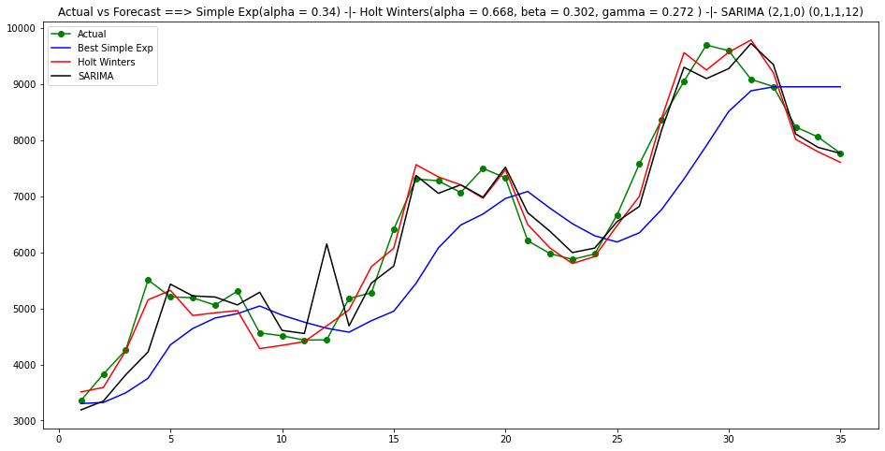
DEMAND FORECASTING
Actual versus forecasts trend across the above models
Sales
Train : July 2009 to March 2012
Holdout

Slide 12


THANKS!
Do you have any questions?
HK
spasula@purdue.edu
+1 765 775 0913
https://www.linkedin.com/in/sai-teja-pasula/

